Slide 1
DB model
Key tables
Key tables
CLIENT
users
STATUS
CALL STATUS
REASON
COMPANY
NUMBERS
YES NO
Client users
IMPORT PHP'S
IMPORT data
Customers
campaign
INKO2016
REPORT data
Customers
REPORT data
Create
PHP's :
Kpis.php
Kpisemail_php
…
INCODE
TICKET
Columns:
Client ID
User_id
Status_id
…
ECO
TICKET_
INKO2016
CSV-
Files
KNP1
TICKET_
INCODE
TICKET_
ECO
CSV-
Files
KNP3
IMPORT customer data
Auxiliary tables
(Duplicates per client!!)
TICKET_
KNP1
TICKET
KNP3
INCODE_urgency
INCODE_duplet
INCODE_multiple
INCODE_multiple2
INKO2016 ….
…
KNP3_urgency …
KNP3_out
KNP1_out
INCODE_out
IMPORT campaign data
Auxiliary tables
(Duplicates per client!!)
EXPORT_PHP for campaigns
IMPORT_PHP Results
from campaigns
CSV-
Files
CSV-
Files

Slide 2
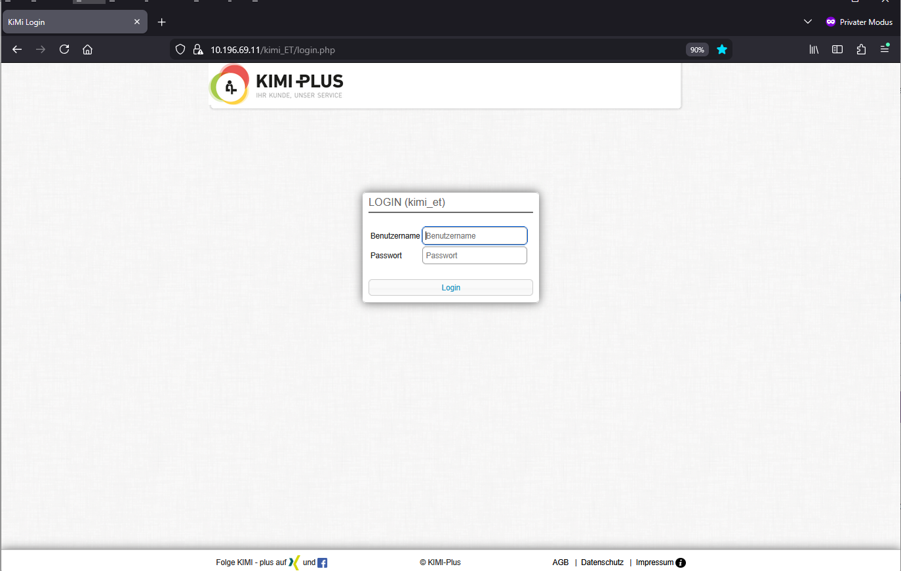
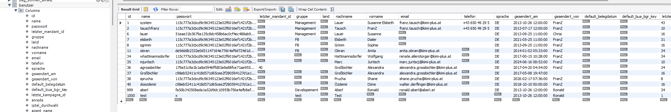
DB:

Slide 3
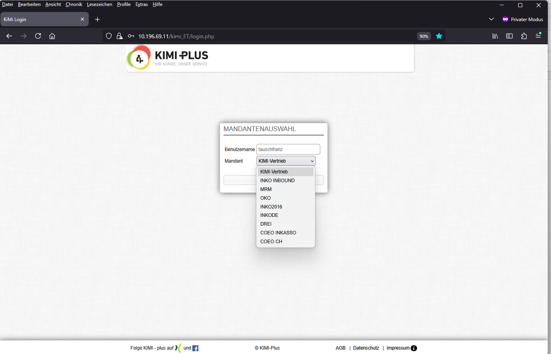
DB

Slide 4
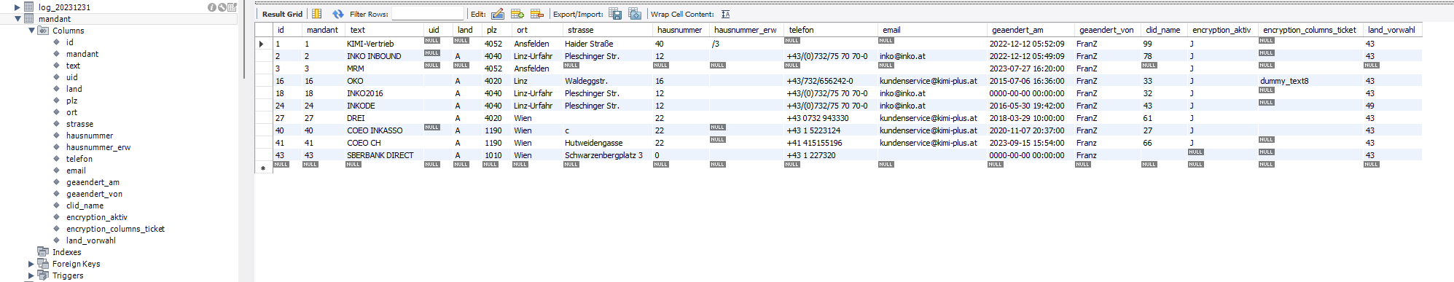
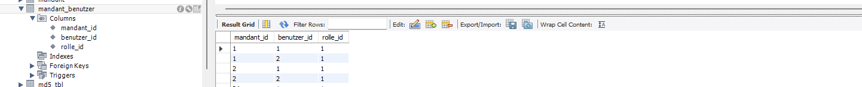
DB
CLIENT
CLIENT_USER
Special features:
Password encrypted
Session cookies – these have recently been causing problems with current Firefox versions, as they are being lost.
and the dialog then no longer works; current workaround : log out, delete cookie, close browser , or use an old browser.
Browser version
ATTENTION: Firefox only

Slide 5
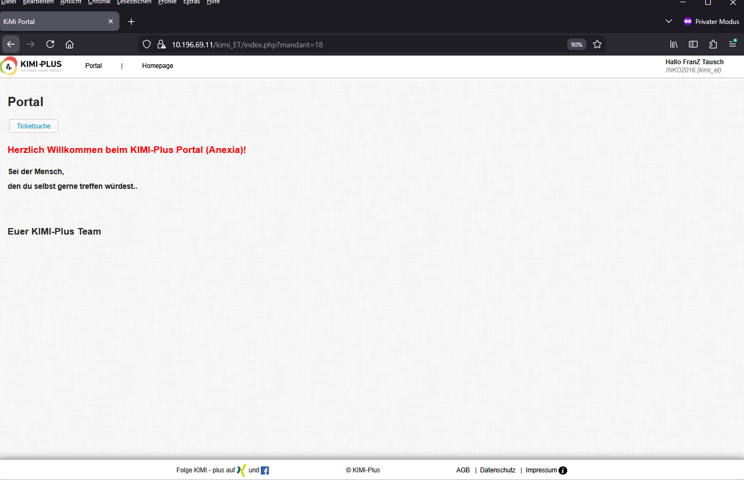

Slide 6
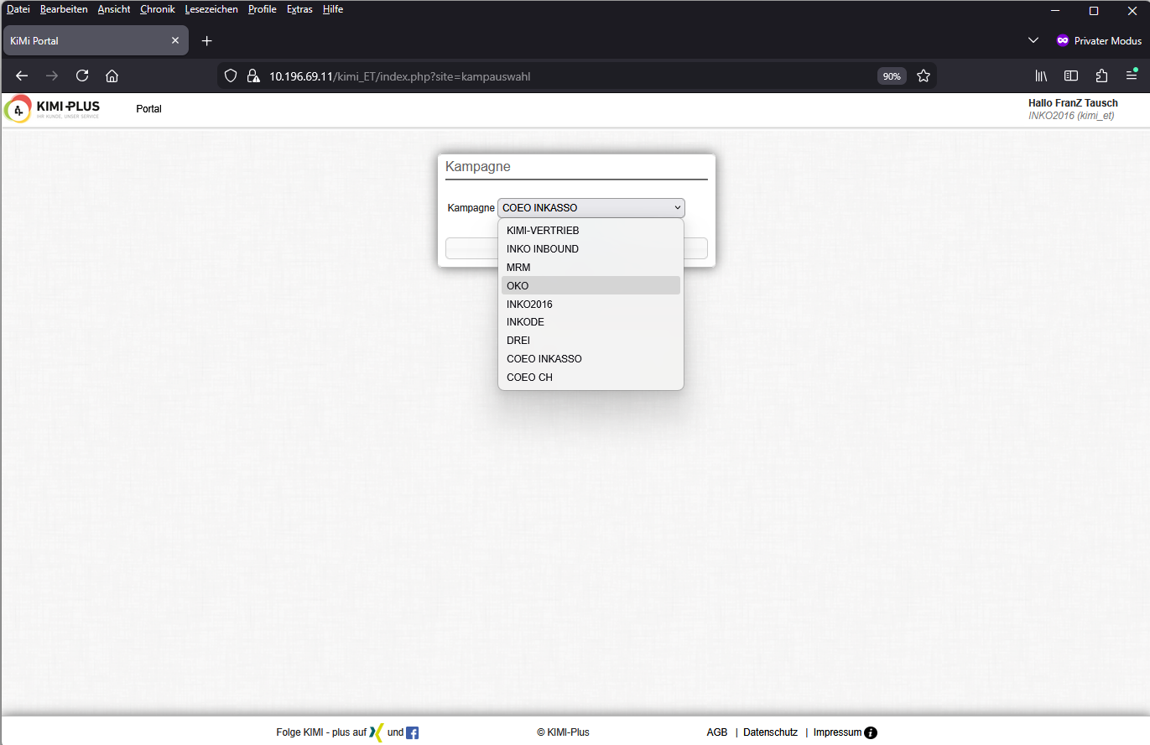
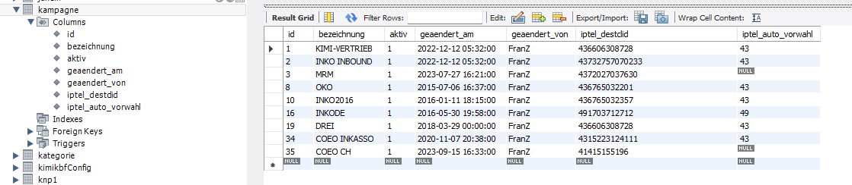
DB

Slide 7
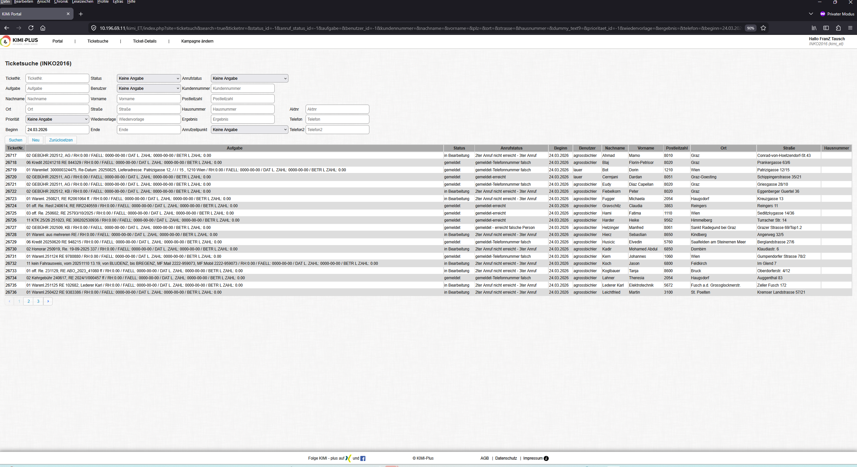

Slide 8
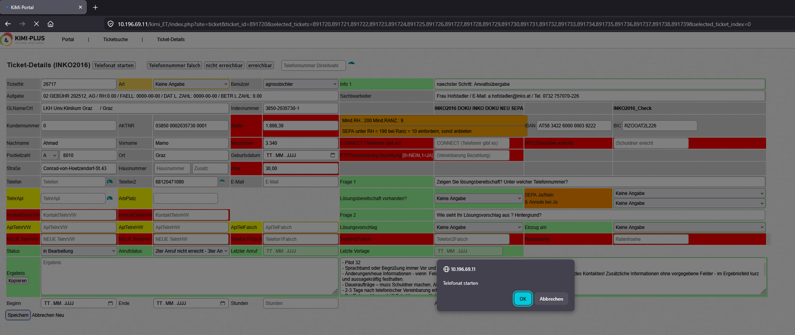

Slide 9
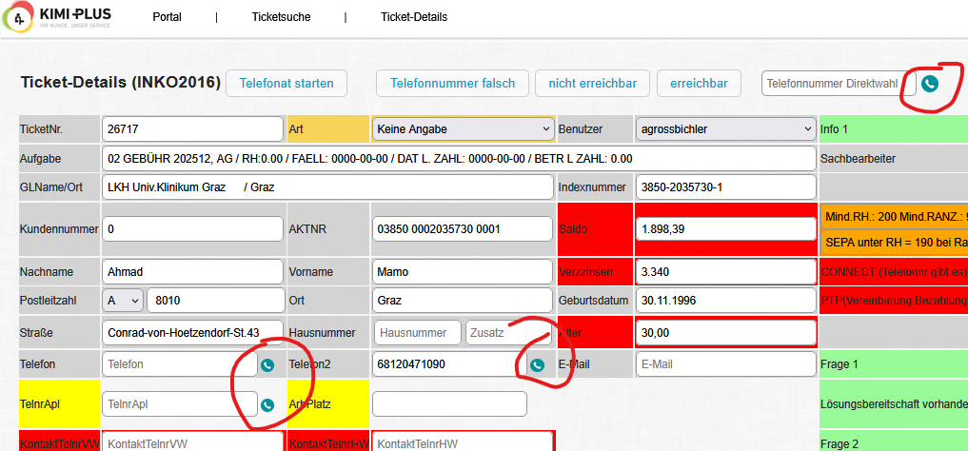

Slide 10
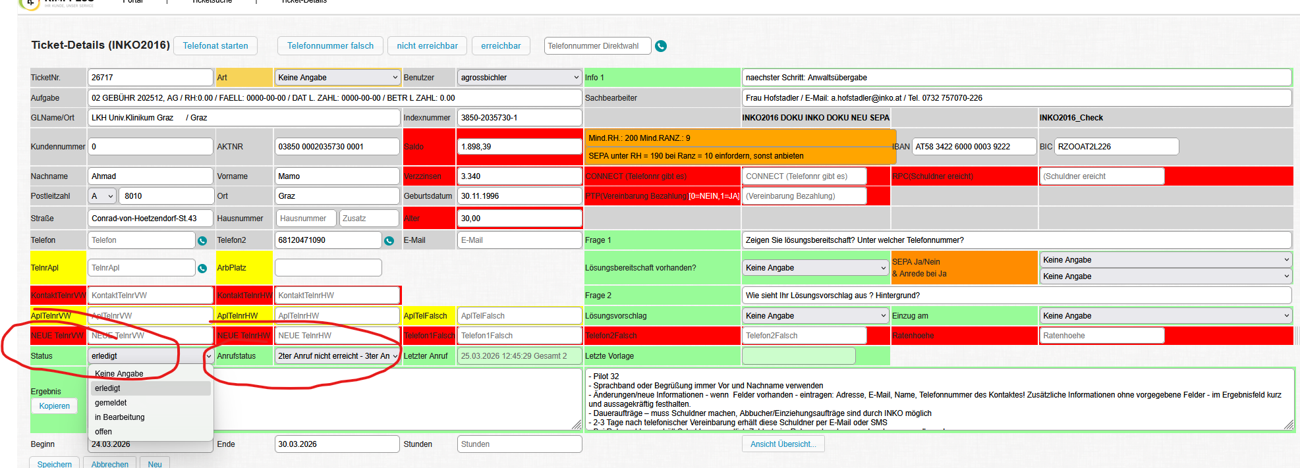
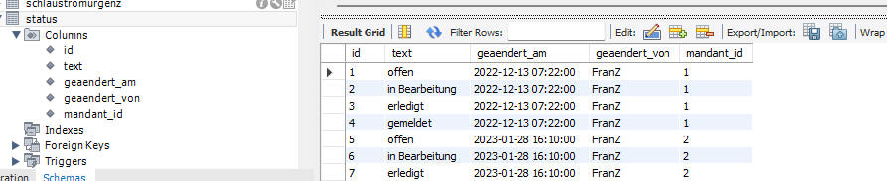
List boxes – tables…
Status,
Call status
user
Proposed solution,
Entry, type, …

Slide 11

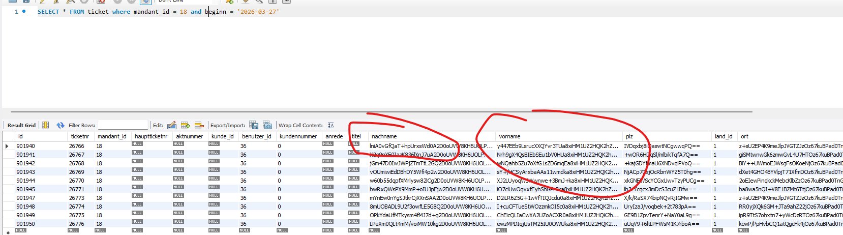
DECYRPT, … - Encryption of personal data

Slide 12
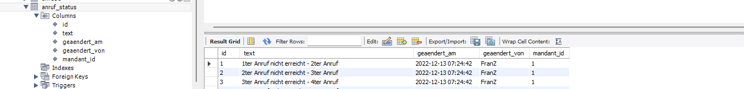
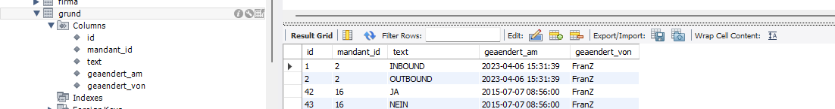
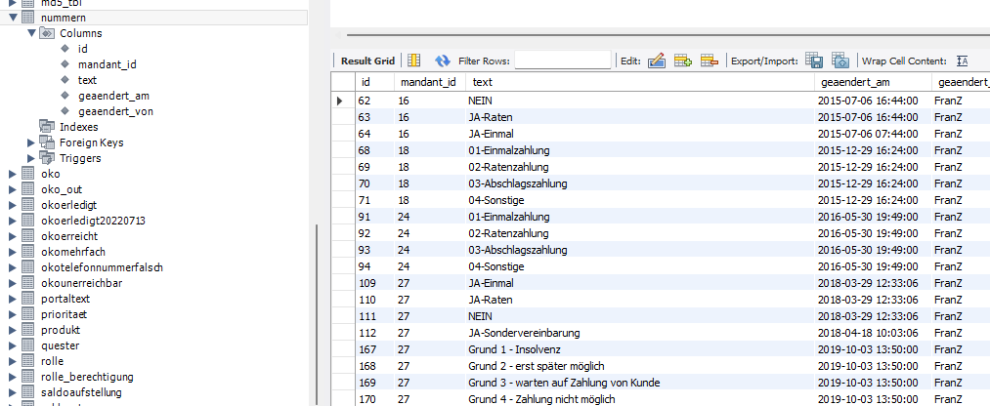
List boxes – tables…
Status,
Call status
user
Proposed solution,
Entry, type…

Slide 13
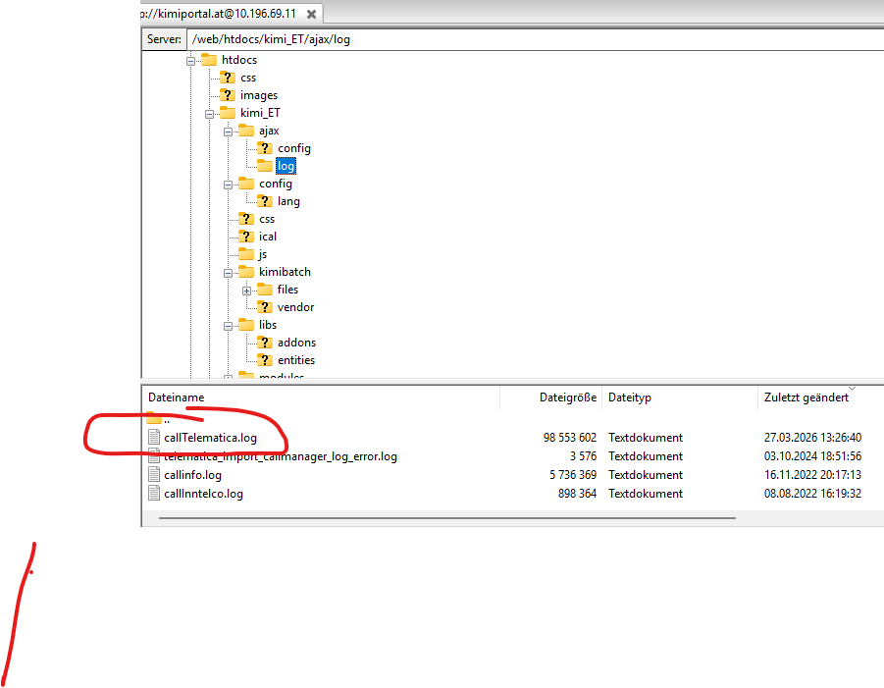
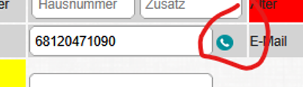
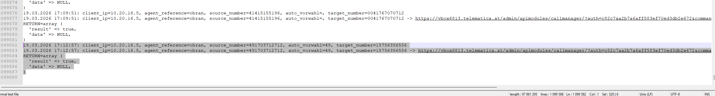
TELEPHONE CALL
https controls local
BRIA5 phone on client
on – then we were called out

Slide 14
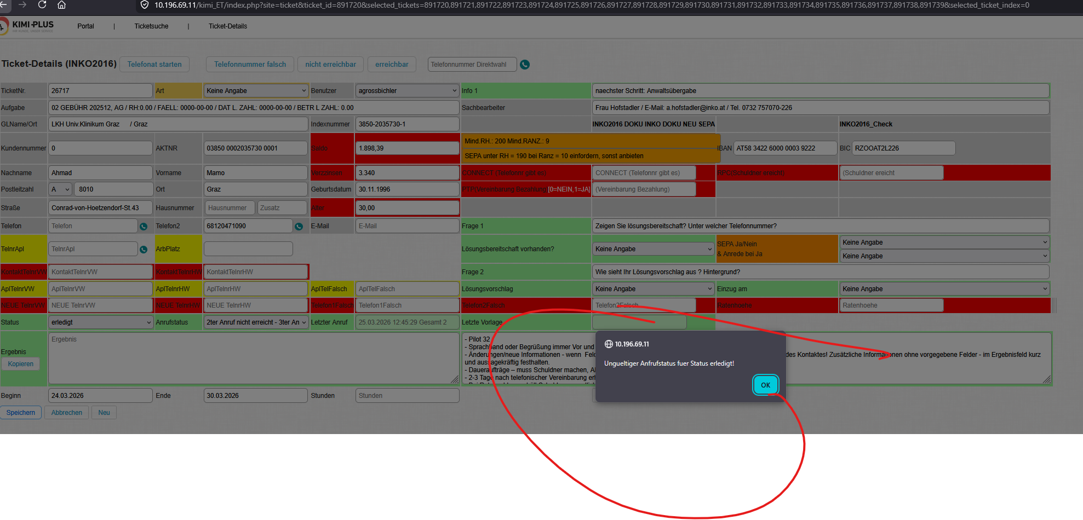
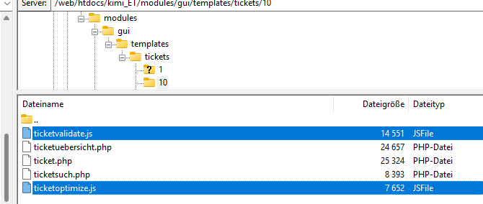
Javascript for validating the input or for
Automatic field filling!!!
Functionally, they are all "pretty much" the same, due to different
Fields contain a lot of redundancy through copies.

Slide 16
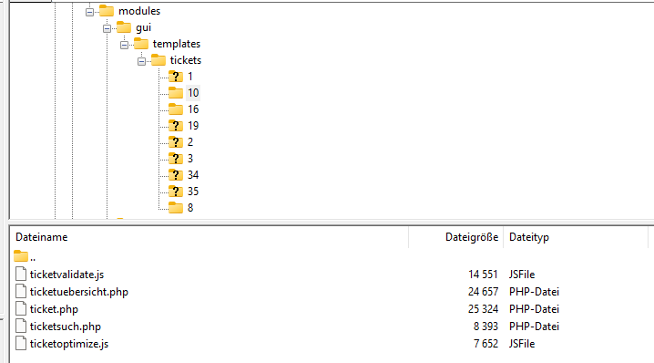
Basic structure of dialogue
Copyable – everything redundant and then adapted,
Control via “ campaign_id ”
DB

Slide 17
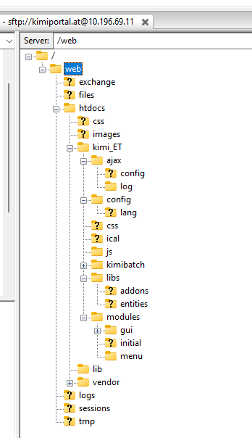
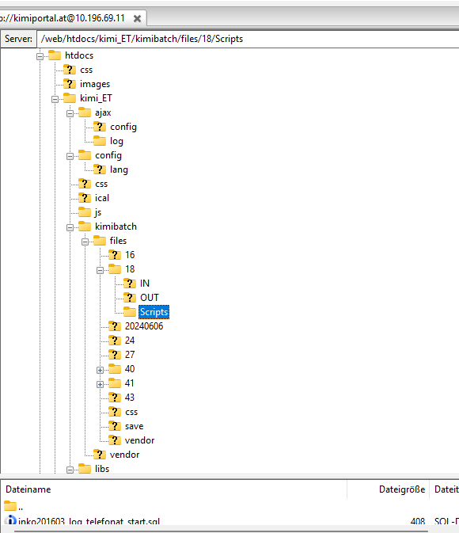

Slide 18
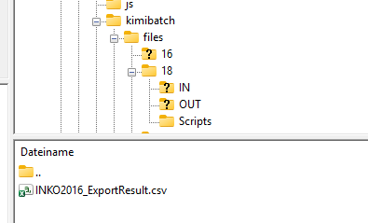
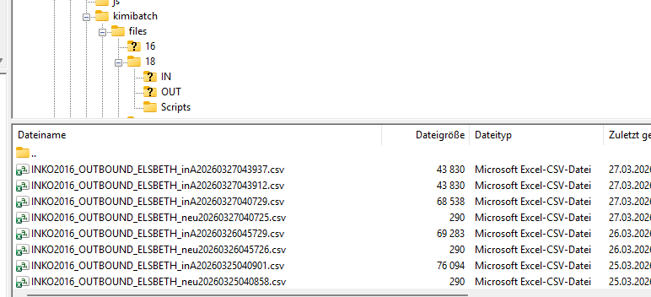
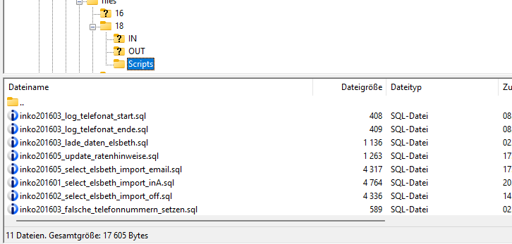
FILE processing for BATCH IMPORT and EXPORT
IN = Import
OUT=Export
Scripts: are for SQL statements that then appear in the batch PHP files.
Read and executed
Purpose = Simplification of programming = only copy and rename,
program code except for name and comments or log outputs
identical, SQL adapted
The only different fields in terms of content are...
90-95% identical function
Many redundancies – copy & paste development

Slide 19
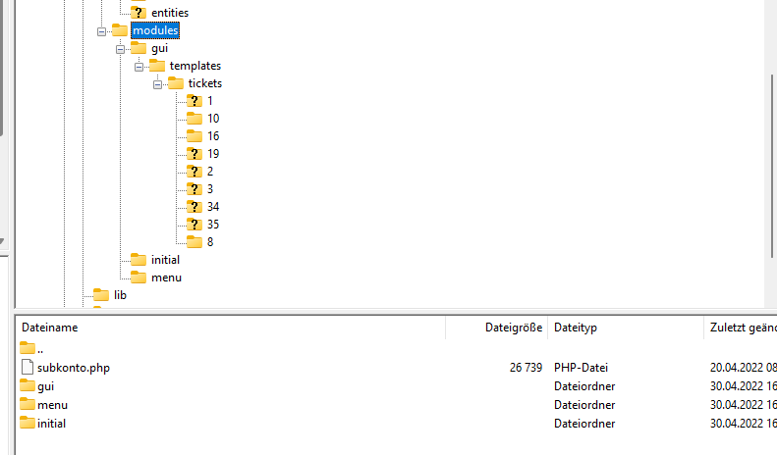
Templates-Ticktes = Ticket dialog modules
Numbered via campaign!!
The only different fields in terms of content are...
90-95% identical function
Many redactions – copy & paste development

Slide 20
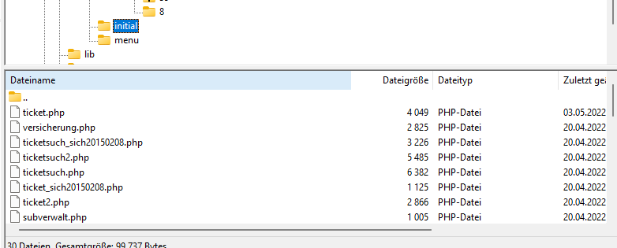

Slide 21
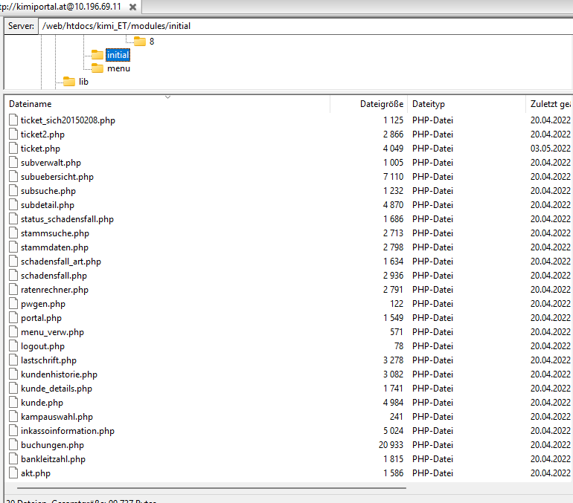
= no longer active

Slide 22
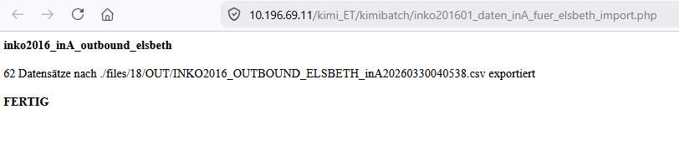
Batch programs
PHP script to load or export data via files and/or tables
Files are read from and written to the IN/ OUT_directory.
This information is output as a log :

Slide 23
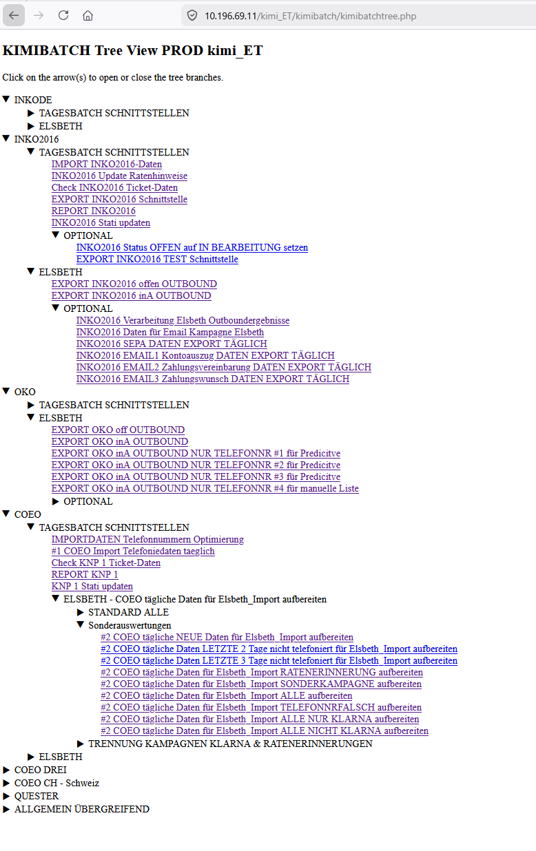

Slide 24
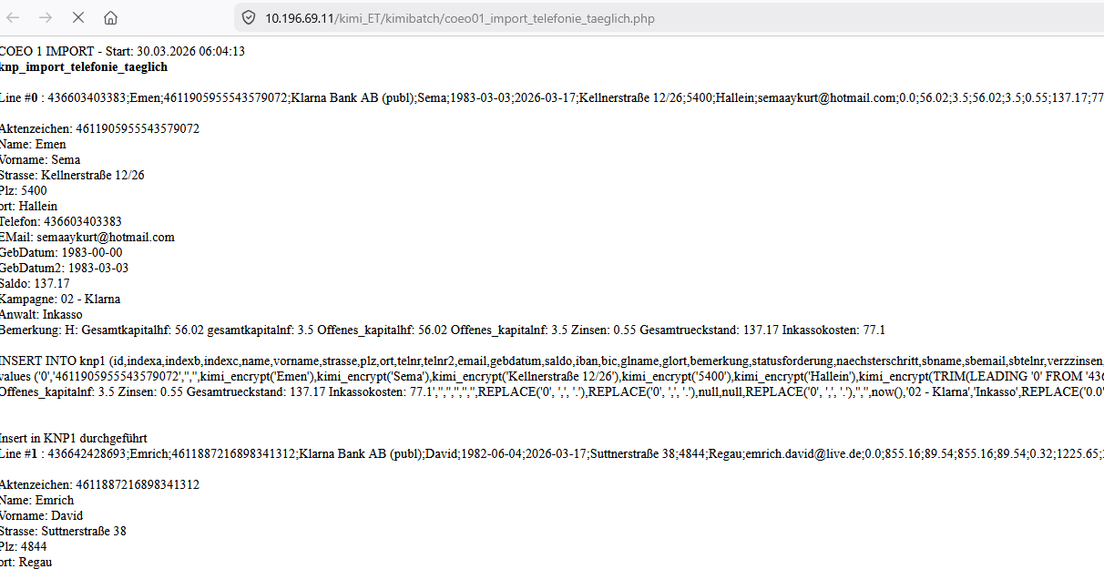

Slide 25
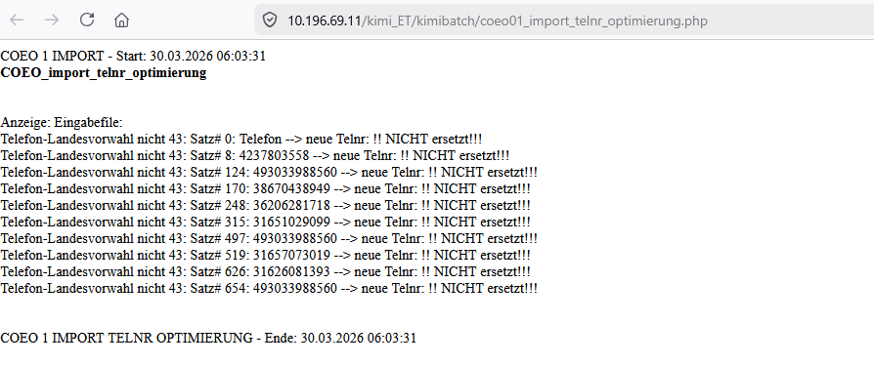
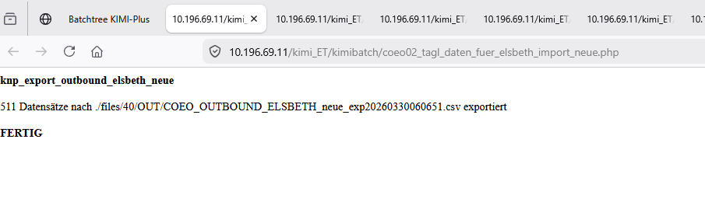

Slide 26
